Slide 1


A Guided Thinking Log
SmartLearning 2020

Slide 2
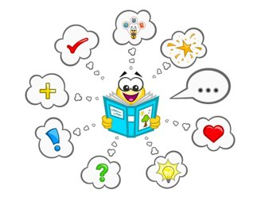
Getting ready to read...
You will need a book to read and paper to sketch and write on.
You can also use the thinking log to watch a video, or to listen to a story being told.

Slide 3
Task... when you finish reading:
Write as a character or someone important in the story to show how you are feeling and what is important and why.

Slide 4
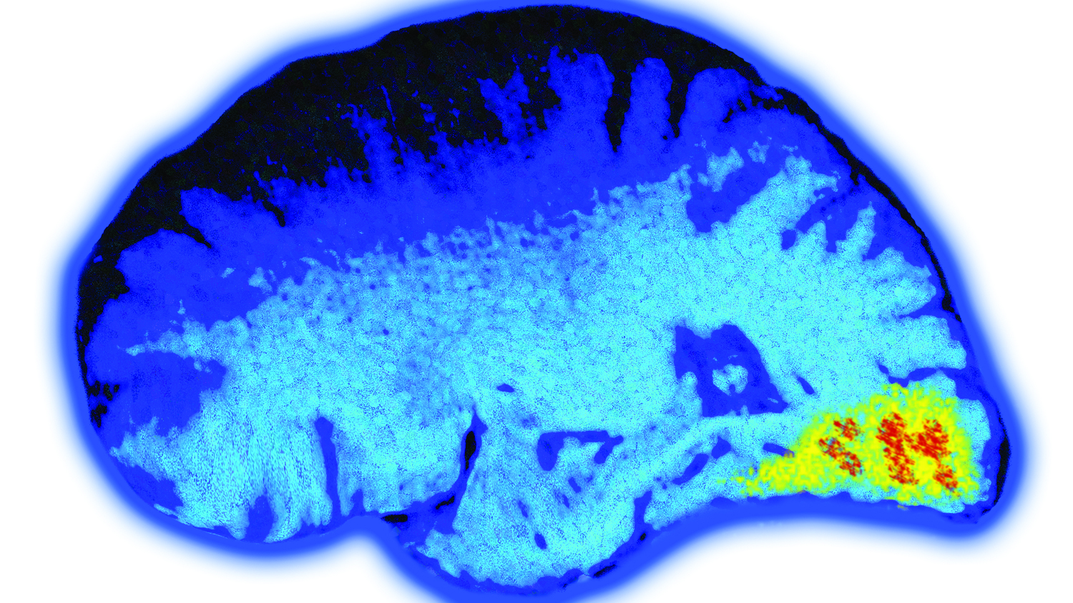
Connecting: "Warming up my brain..."
You might do this part orally by talking with someone at home, or you might choose to sketch & write your thoughts...
What do you know about your book so far?
I know...
What are you wondering & why?
I’m wondering... because...
What questions do you want the story to answer?
What do you predict will be important in your book today?
I predict... will be important today. I think this because...

Slide 5
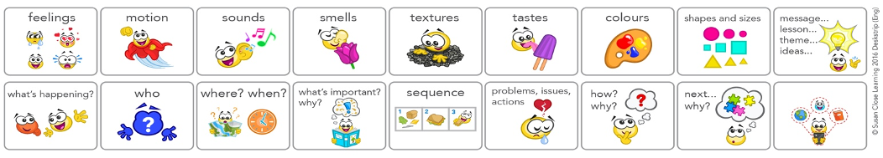
S-T-R-E-T-C-H goal for reading:
Capture what is important to remember
To help me achieve my s-t-r-e-t-c-h goal, I plan to focus on: (circle 2 or 3)

Slide 6
Read... for 5-10 minutes
Think like the main character... on your paper, sketch to show what’s important to remember from the book.
Include important details, especially the ones you circled

Slide 7
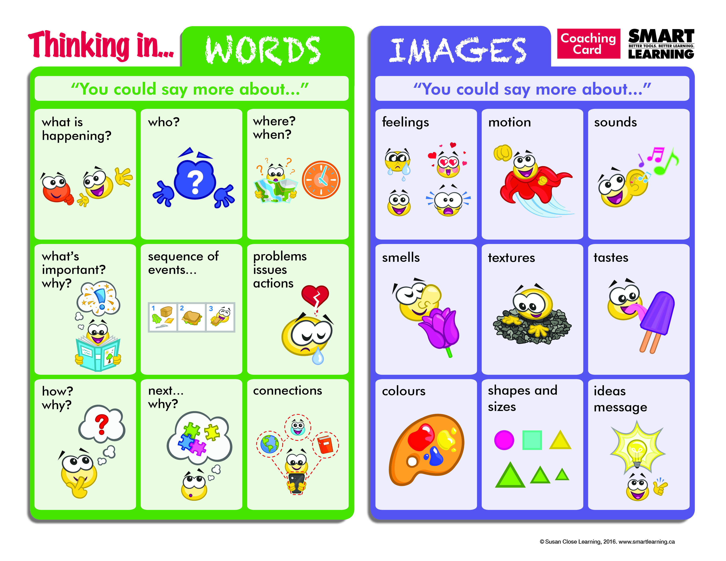
Looking at your picture:
€ Talk to explain your picture. Send an image of what's important into the person’s thinking: I’m picturing…
€ Listen as someone coaches you to say more about your picture: You could say more about...
Add any new details to your sketch!

Slide 8

Thinking about your picture:
Think of 5-7 words that capture what was important in this part of the story.
The words need to send a picture and a feeling of what is important.
We call the 5-7 words a Tagline.
Write your tagline below your picture

Slide 9
Read again... for 5-10 minutes
Think again like the main character... on your paper, sketch to show what’s important to remember from the book.
Include important details, especially the ones you circled

Slide 10
Looking at your picture:
€ Talk to explain your picture. Send an image of what's important into the person’s thinking: I’m picturing…
€ Listen as someone coaches you to say more about your picture: You could say more about...
Add any new details to your sketch!

Slide 11
Thinking about your picture:
Think of 5-7 words that capture what was important in this part of the story.
The words need to send a picture and a feeling of what is important.
We call the 5-7 words a Tagline.
Write your tagline below your picture

Slide 12
Read again... for 5-10 minutes
Think again like the main character... on your paper, sketch to show what’s important to remember from the book.
Include important details, especially the ones you circled

Slide 13
Looking at your picture:
€ Talk to explain your picture. Send an image of what's important into the person’s thinking: I’m picturing…
€ Listen as someone coaches you to say more about your picture: You could say more about...
Add any new details to your sketch!

Slide 14
Thinking about your picture:
Think of 5-7 words that capture what was important in this part of the story.
The words need to send a picture and a feeling of what is important.
We call the 5-7 words a Tagline.
Write your tagline below your picture

Slide 15

Take a picture of your work so far…
Snap your sketches and your taglines
This Photo by Unknown Author is licensed under CC BY-SA

Slide 16
Your task:
Write in role as the main character to show what is important in your story and why it is important.
Use evidence in the story to support your thinking.
Set the image: See yourself in the story… notice the background… see the colours… notice the sizes… notice who is with you… notice feelings…hear the talking… notice the thinking… actions… notice what seems to be important

Slide 17
Click the link below for where to type
Teachers could insert the link to a Google Doc Assignment where students can write to or whatever process they have set up

Slide 18
Reflecting
Look at your s-t-r-e-t-c-h goal. Look at the icons you chose to focus on. Find evidence in your work that you met your goals. What did you notice about your learning?
I noticed...
What strengths did you notice in your learning today? I noticed...

